Slide 1
TJAGLCS Training Package
Presidential Drawdown Authority (PDA)
December 2024

Slide 2
The information provided throughout this training aid does not, and is not intended to, constitute legal advice; instead, all information, laws, statues, content, and materials for this training aid are for general informational purposes only. This training aid may not constitute the most up-to-date legal or other relevant legal information. Judge Advocates need to conduct their own due diligence through independent further legal research on any specific legal issue contained in this training package. No reader, user, or trainee of this product should act or refrain from acting based on information from this training aid without first seeking legal advice from an attorney in the relevant jurisdiction.

Slide 3
Presidential Drawdown Authority (PDA)

Slide 4
References
The Foreign Assistance Act of 1961, Section 506 (10 U.S.C. 2318)
U.S. Department of State, Use of Presidential Drawdown Authority for Military Assistance for Ukraine, Fact Sheet, November 20, 2024, available at https://www.state.gov/use-of-presidential-drawdown-authority-for-military-assistance-for-ukraine/

Slide 5
Presidential Drawdown Authority
Foreign Assistance Act
Authorizes the President to direct transfers of articles and services from the inventory and resources of any agency of the USG to support foreign countries and international organizations in response to unforeseen military emergencies or for other legislatively authorized purposes
Sec. 506(a)(1) DoD Drawdown for Unforeseen Emergencies
Sec. 506(a)(2) DoD Drawdown for:
Narcotics Control or Antiterrorism Assistance
International Disaster Assistance
Nonproliferation Assistance
Migration and Refugee Assistance
Cooperative efforts in Cambodia, Laos, and Vietnam to repatriate POW/MIA
Sec. 552(c)(2) DoD Drawdown for Peacekeeping Operations

Slide 6
FAA, Sec. 506(a)(1) aka 22 U.S.C. § 2318(a)(1)
Authorizes the President to direct DoD drawdowns for unforeseen emergencies requiring immediate military assistance that cannot be addressed under the Arms Export Control Act or any other law
Requires the President to report to Congress that an unforeseen emergency required immediate military assistance
May provide defense articles already on hand in DoD stocks, DoD services, and military education and training
May include the supply of commercial transportation and related services if the cost of commercial transportation is less than the cost of USG provided transportation

Slide 7
Statutory Cap on PDA?
Aggregate value of all drawdowns directed in any FY under this authority may not exceed $100M under 22 U.S.C. § 2318(a)(1).
FY2024 National Security Supplemental Appropriations Act, PL 118-50

Slide 8
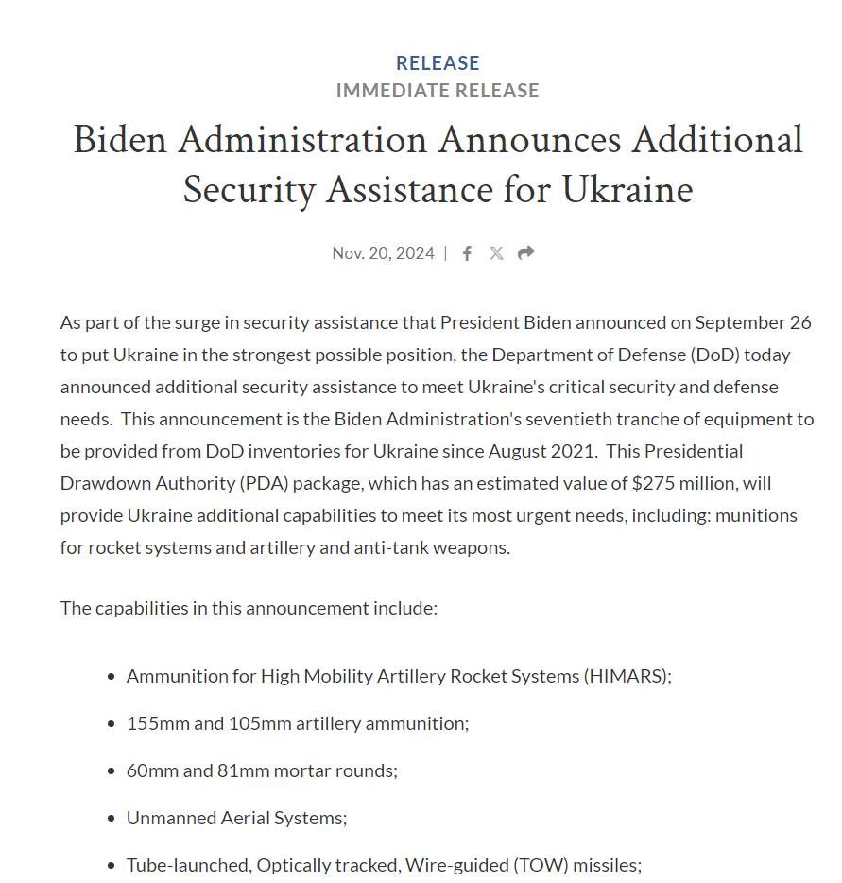
PDA for Ukraine
Since August 2021, the United States has been providing defense article to Ukraine utilizing PDA.
As of 20 November 2024, the United States was on PDA drawdown 70 for Ukraine.

Slide 9
Need Training Materials?
Have Training Materials?
Questions?
Contact Us!
TJAGLCS-training@army.mil

